Slide 1
THE LANGUAGE OF
Jayalakshmi Jain

Slide 2
Data
Scraped off the website using selenium
3000 projects

Slide 3
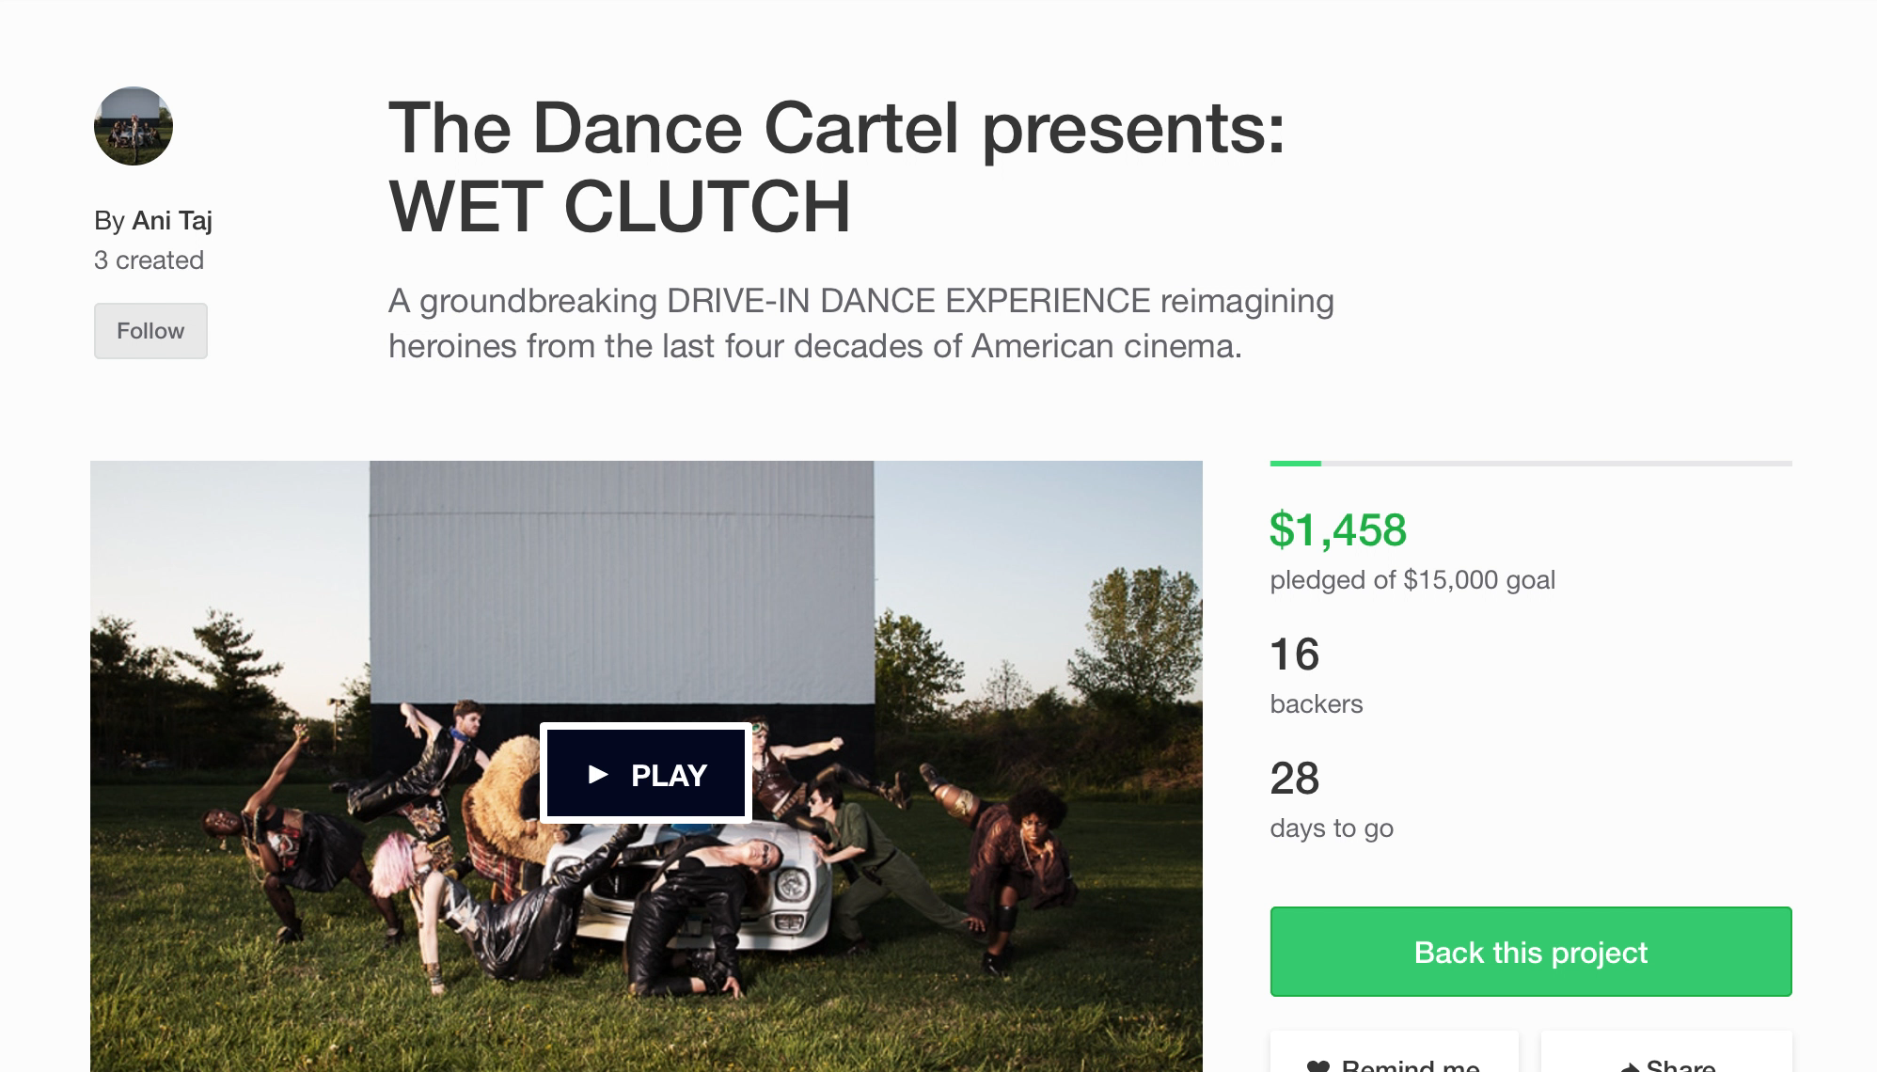

Slide 4
Objective

Slide 5
Objective
Use NLP and unsupervised learning techniques to analyze Kickstarter description and to see what categories of projects emerge.

Slide 6
Overview
Text Cleaning
Removed non-ascii chars, non-English words
Tokenization (spaCy)
Lemmatization
Vectorization (CountVectorizer)
49740 features
Removed rare features (<25 occurrences)
5000 features
Dimensionality Reduction and Topic Modelling (LDA)
6 features
Clustering (kMeans) 6 clusters
Analysis of clusters
Text Cleaning
Removed email ids, links, stop words etc.

Slide 7
Step 1
Text Cleaning
Removed non-ascii chars, non-English words

Slide 8
Step 2
Text Cleaning
Removed non-ascii chars, non-English words
Text Cleaning
Removed email ids, links, stop words etc.

Slide 9
Step 3
Text Cleaning
Removed non-ascii chars, non-English words
Tokenization (spaCy)
Lemmatization
Text Cleaning
Removed email ids, links, stop words etc.

Slide 10
Step 4
Text Cleaning
Removed non-ascii chars, non-English words
Tokenization (spaCy)
Lemmatization
Vectorization (CountVectorizer)
49740 features
Text Cleaning
Removed email ids, links, stop words etc.

Slide 11
Step 5
Text Cleaning
Removed non-ascii chars, non-English words
Tokenization (spaCy)
Lemmatization
Vectorization (CountVectorizer)
49740 features
Removed rare features (<25 occurrences)
3259 features
Text Cleaning
Removed email ids, links, stop words etc.

Slide 12
Step 6
Text Cleaning
Removed non-ascii chars, non-English words
Tokenization (spaCy)
Lemmatization
Vectorization (CountVectorizer)
49740 features
Removed rare features (<25 occurrences)
3259 features
Dimensionality Reduction and Topic Modelling (LDA)
6 features
Text Cleaning
Removed email ids, links, stop words etc.

Slide 13
Step 7
Text Cleaning
Removed non-ascii chars, non-English words
Tokenization (spaCy)
Lemmatization
Vectorization (CountVectorizer)
49740 features
Removed rare features (<25 occurrences)
3259 features
Dimensionality Reduction and Topic Modelling (LDA)
6 features
Clustering (kMeans) 6 clusters
Text Cleaning
Removed email ids, links, stop words etc.

Slide 14
Step 8
Text Cleaning
Removed non-ascii chars, non-English words
Tokenization (spaCy)
Lemmatization
Vectorization (CountVectorizer)
49740 features
Removed rare features (<25 occurrences)
3259 features
Dimensionality Reduction and Topic Modelling (LDA)
6 features
Clustering (kMeans) 6 clusters
Analysis of clusters
Text Cleaning
Removed email ids, links, stop words etc.

Slide 15
Dimensionality Reduction and Topic Modeling

Slide 16
TOPIC: FILM & MUSIC

Slide 17
TOPIC: PUBLISHING (books)

Slide 18
TOPIC: FOOD

Slide 19
TOPIC: GAMES

Slide 20
TOPIC: LUXURY ITEMS

Slide 21
TOPIC: COMMUNITY & AWARNESS

Slide 22
Cluster Analysis
Custer 1 – weighs majorly towards topic Books

Slide 23
Cluster Analysis
Cluster 2 – weighs majorly towards topic Film and Music

Slide 24
Cluster Analysis
Cluster 6 – weighs majorly on topic Community

Slide 28
Observations
Make a new category called “Community / Awarness”

Slide 29
THANK YOU
jlakshmi235@gmail.com
Jlakshmi235

